Slide 1
Eye Tracking Goggles
Group 29
Patrick Gonzalez CpE Michael Fillinger CpE James Curtis EE Timothy Wells EE
Notes:
Introduce Ourselves

Slide 2
Motivation
The ability to control machines through sight
Be able to use it inside things like helmets or goggles
Through less complex means than camera, like IR
Cheaper alternative to eye tracking as opposed to using a camera
Notes:
Patrick

Slide 3
Goals and Objectives
Create
Create an array of sensors around each eye
Convert
Convert the data to digital signal to be read by a microcontroller
Develop
Develop an algorithm for the microcomputer to determine the eyes position
Use
Utilize the algorithm to incorporate eye tracking into an application
Notes:
Patrick

Slide 4
Specifications
Component | Parameter | Specification
Battery | Operational Time | > 1 hour
Goggles | Weight | < 5 pounds
Processing Unit | Response Time | < 50 milliseconds
A/D Converter | Resolution | >= 8 bits
Goggles | Size | 56 cm – 65 cm (Circ.)
Notes:
Patrick

Slide 5
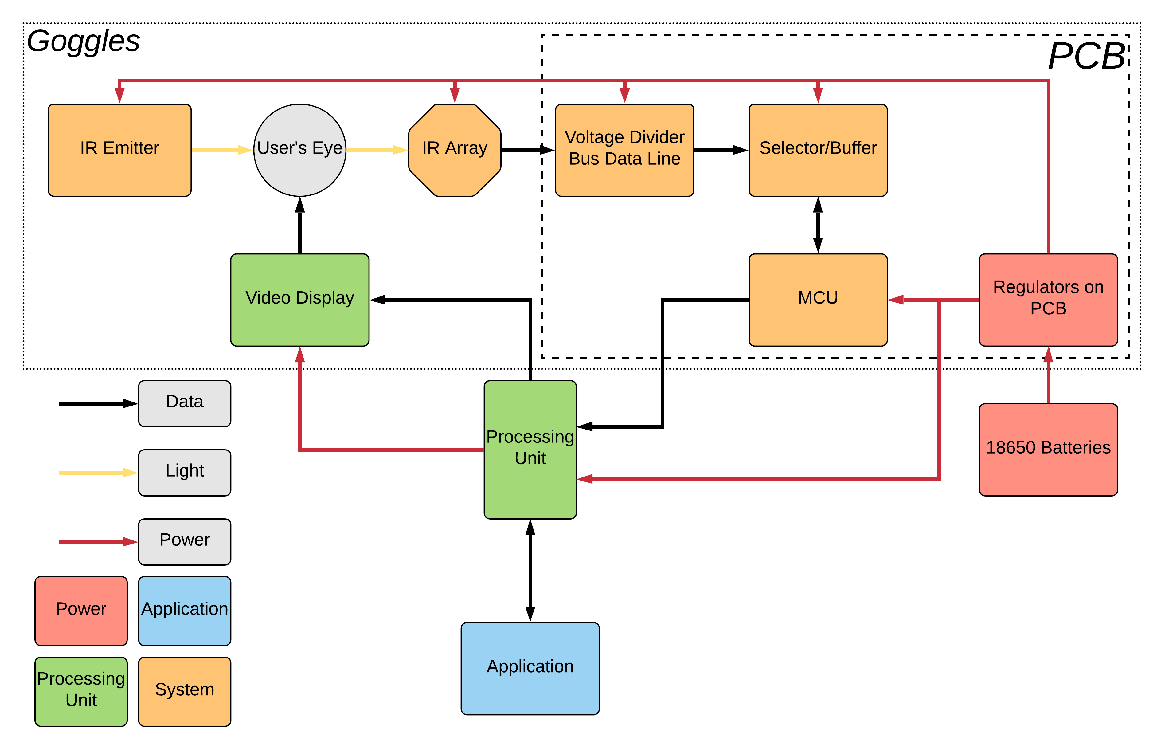
Block Diagram
Notes:
Patrick Explain Coloration

Slide 6
Project Design Approach
Use IR emitters to shine light on the eye
Use IR detectors to retrieve the reflected light
Use the MCU to process the signal from the detectors, convert it to a value and transmit to the microcomputer
The microcomputer will then analyze the data and apply it accordingly
Notes:
Tim

Slide 7
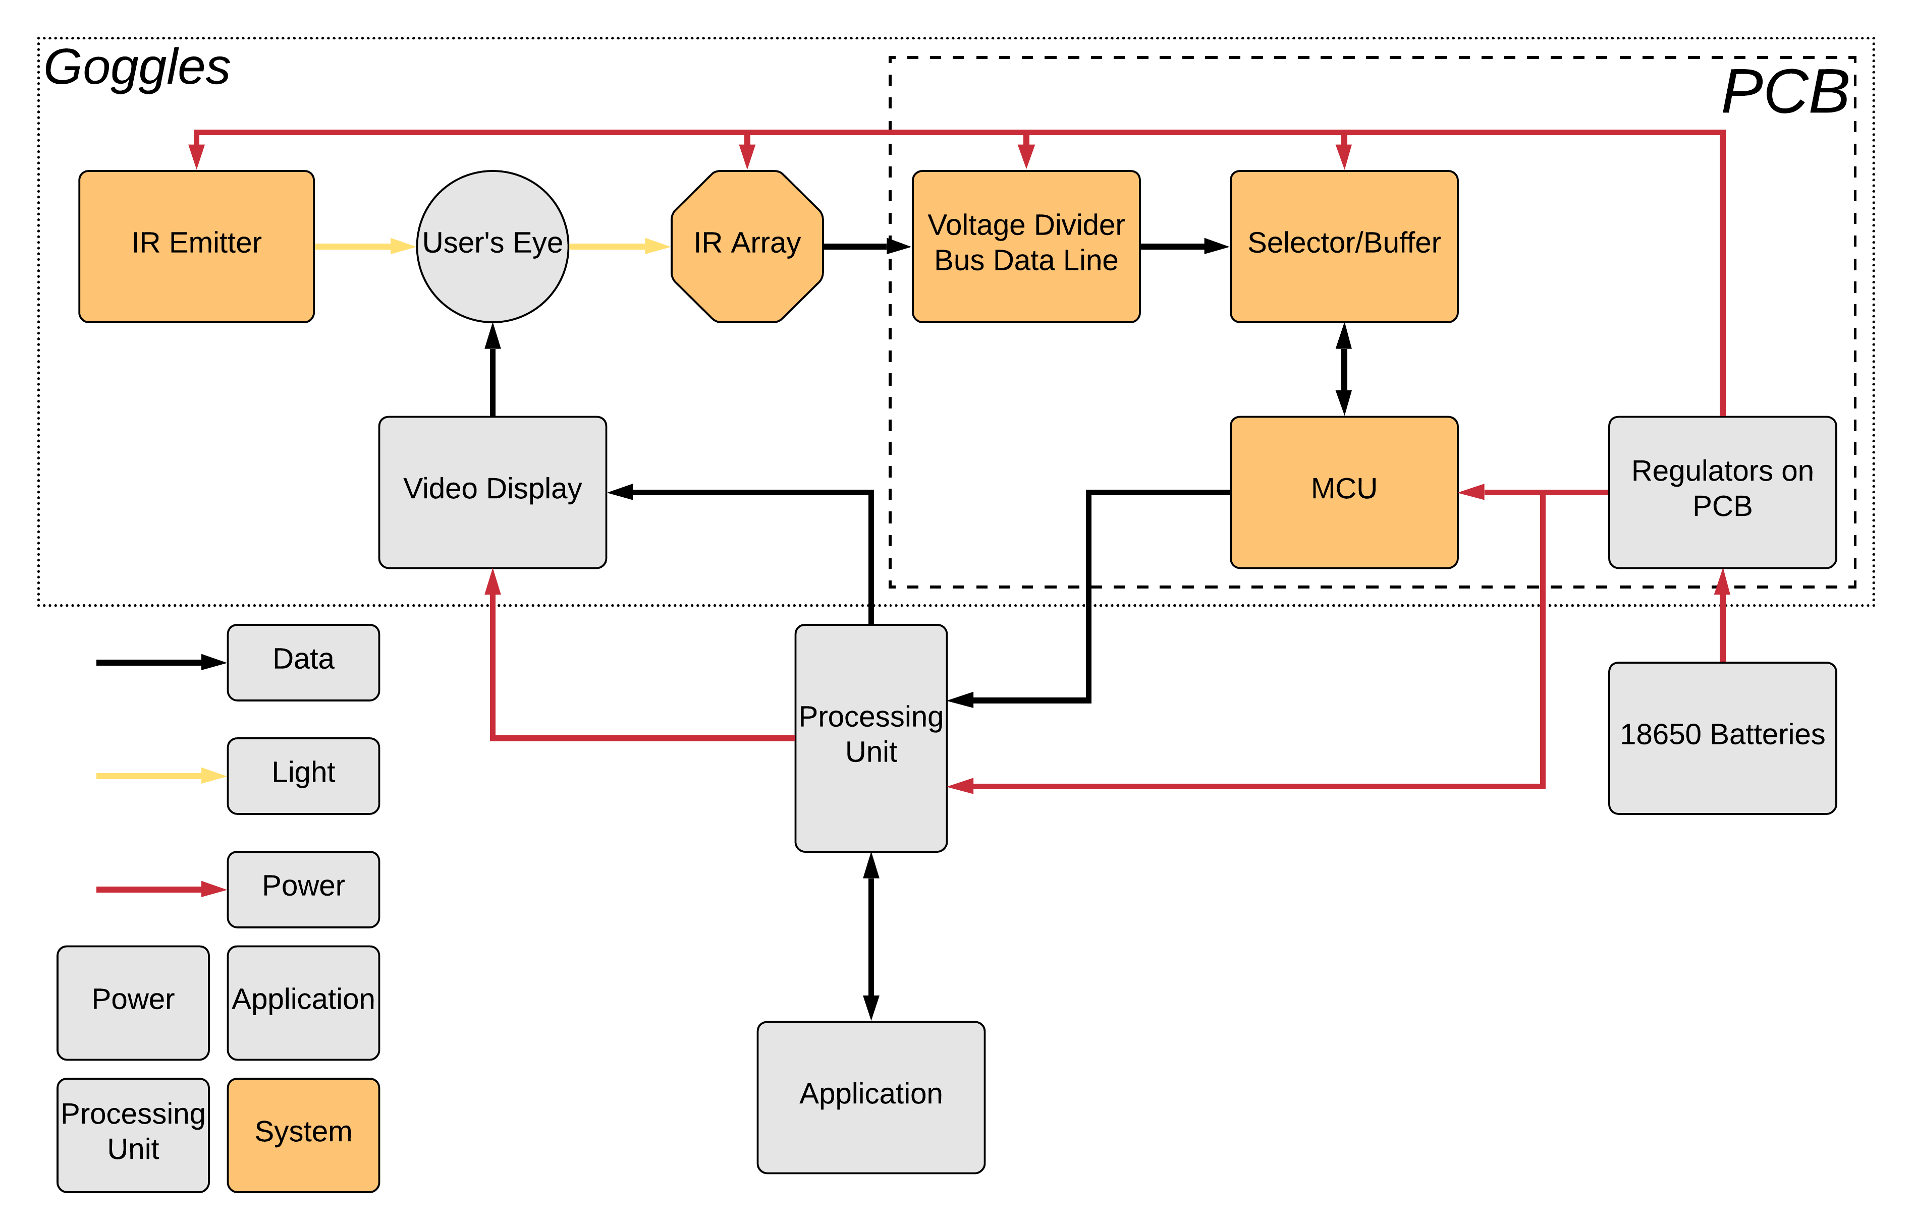
System

Slide 8
Reasoning IR array vs Camera
+/- Simpler data flow
+ half of the data is processed outside the main processor
+ Mostly a closed system
- less accurate tracking
+ Higher accuracy
- high data usage
- more computation
- - more sensitive to environmental lighting
Notes:
timothy

Slide 9
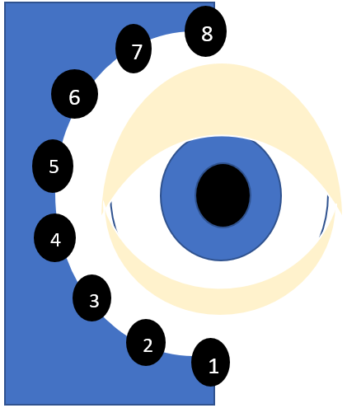
Concept of our system
16 IR sensors 8 right and 8 left
IR array
Array | right | left
Sensor 1 | medium | …...
Sensor 2 | medium | …...
Sensor 3 | low | …...
Sensor 4 | low | …...
Sensor 5 | medium | …...
Sensor 6 | medium | …..
Sensor 7 | high | …..
Sensor 8 | high | …..
Notes:
timothy

Slide 10
Concept of our system
IR array
MCU
Data from array
Analog to Digital Conversion
Sensor Data
Microcomputer
application
Eye state algorithm
External Communication Protocol
Notes:
timothy

Slide 11
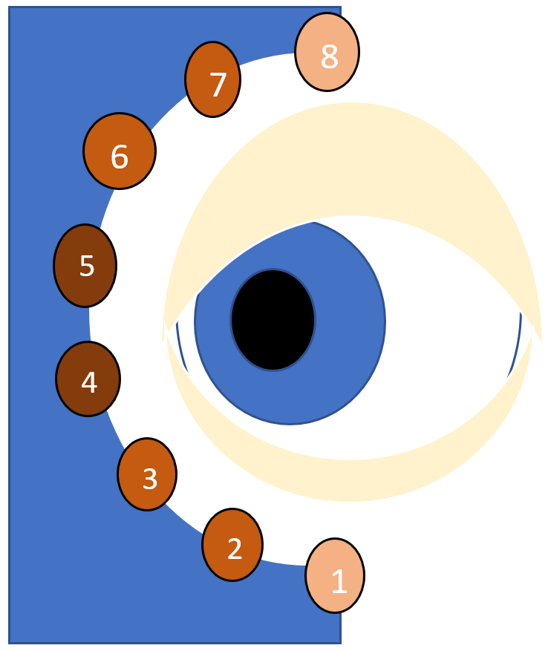
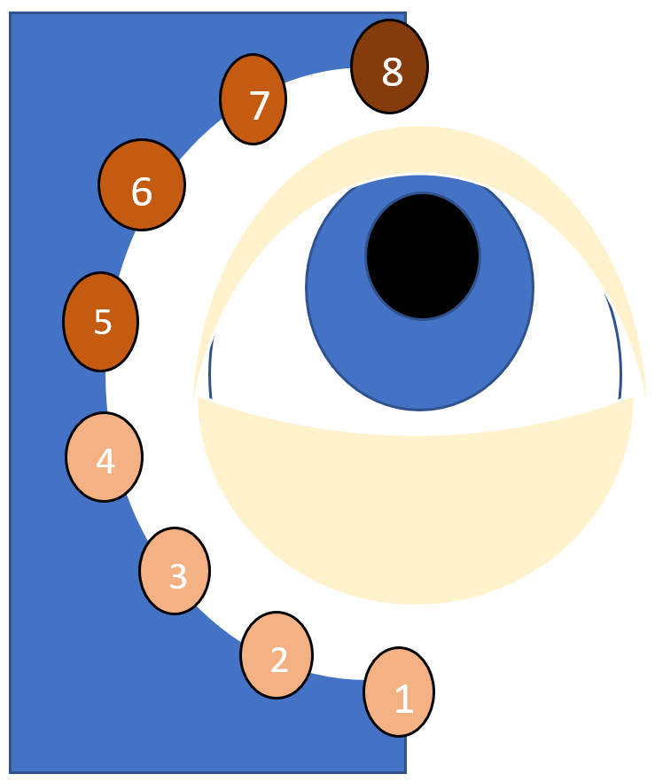
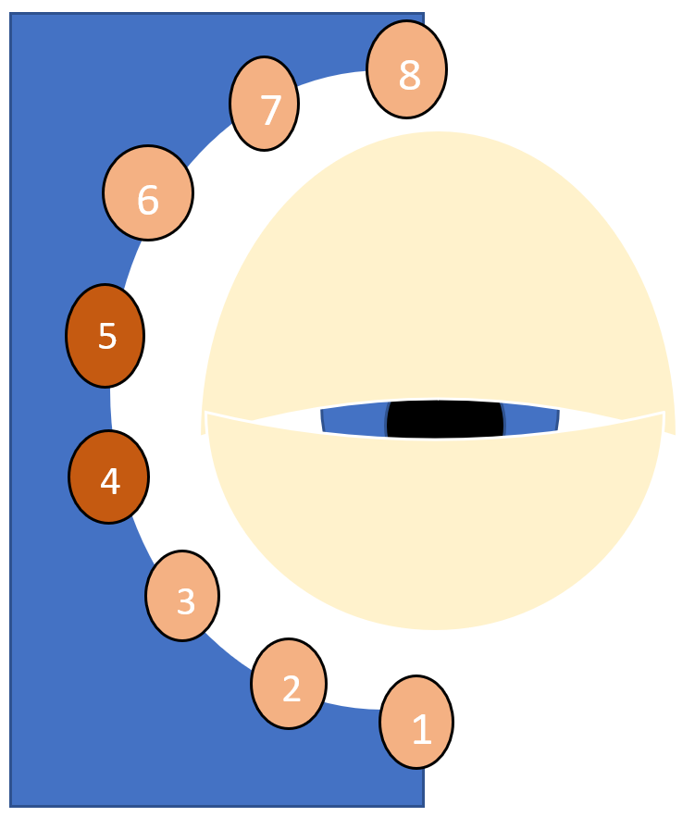
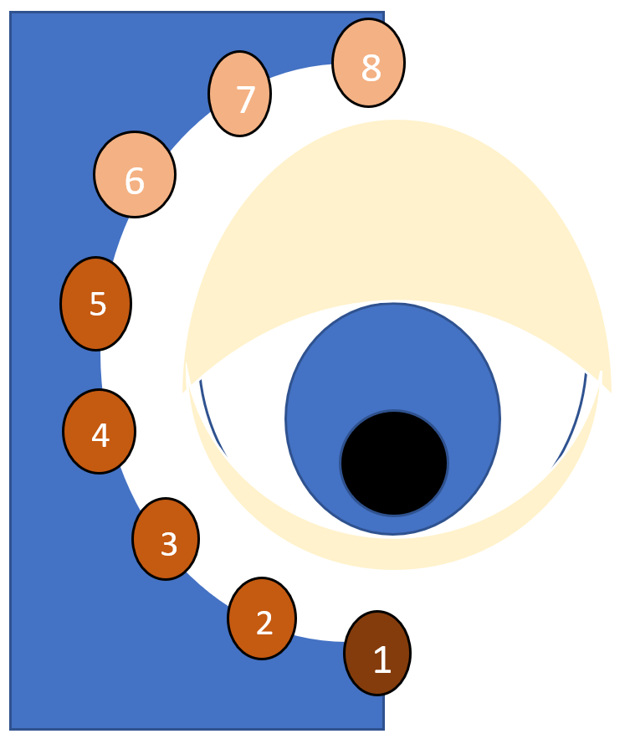
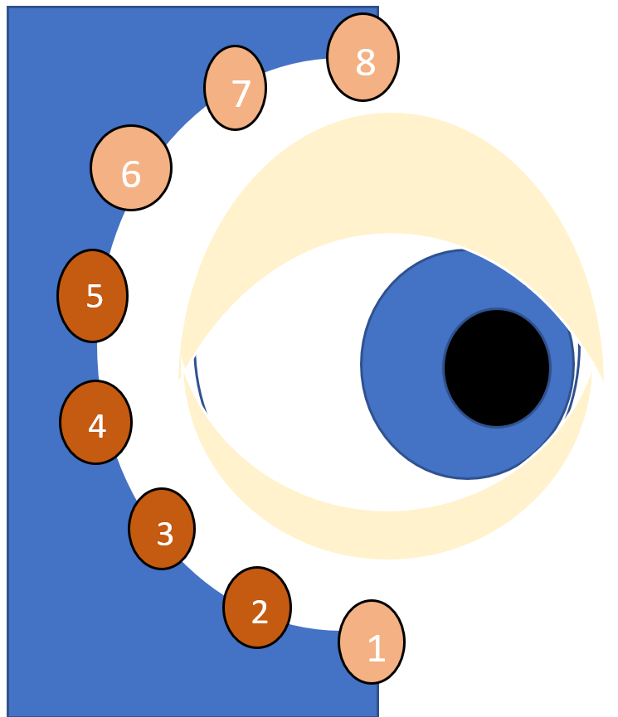
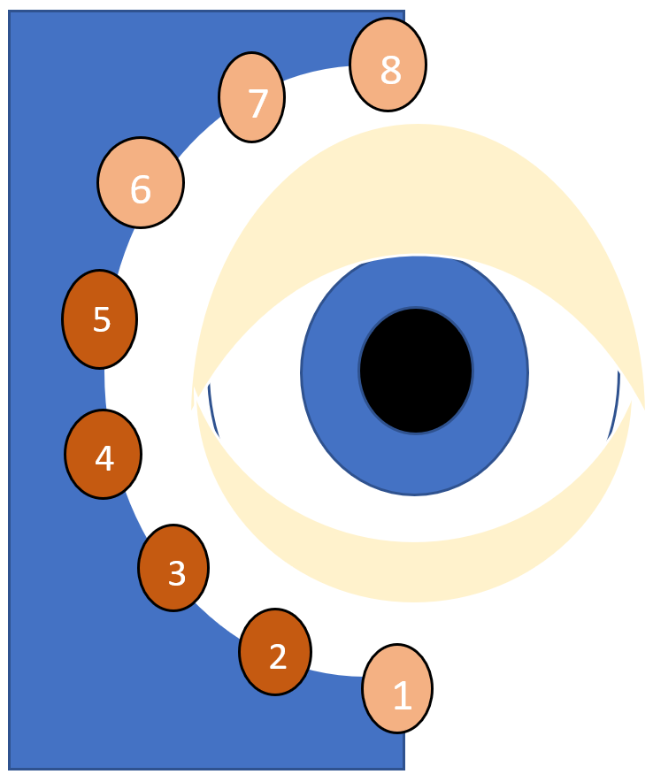
example
left
up
closed
down
right
straight
Notes:
timothy

Slide 12
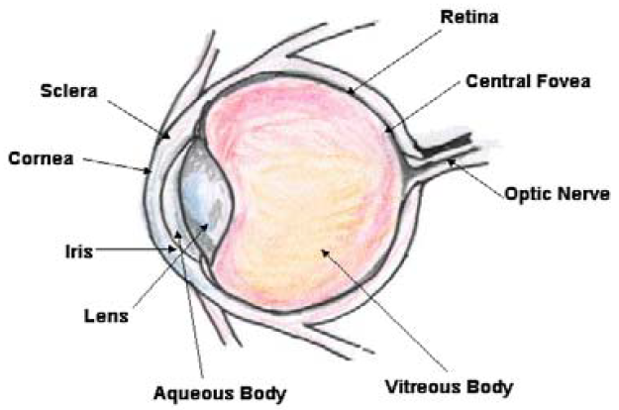
Health and Safety Standards for Eye Exposure to Infrared Light
IEC-62471 Standard Photobiological Safety of Lamps and Lamp Sources
Corneal Hazard Exposure Limits
Retinal Hazard Exposure Limits
Notes:
Patrick

Slide 13
Calculations of Hazardous Eye Exposure to Infrared Radiation
 | Time Exposed | Exposure Limit | Measured Exposure | Safety Factor Ratio
Corneal Eye Exposure Data | 600 seconds (10 minutes) | 148.48 W/m | 3.383 W/m | 43.89
Retinal Eye Exposure Data (Weak Visual Stimulus) | 600 seconds (10 minutes) | 320000 W/m /Sr | 3874.231 W/m /Sr | 82.60
2
2
2
2

Slide 14
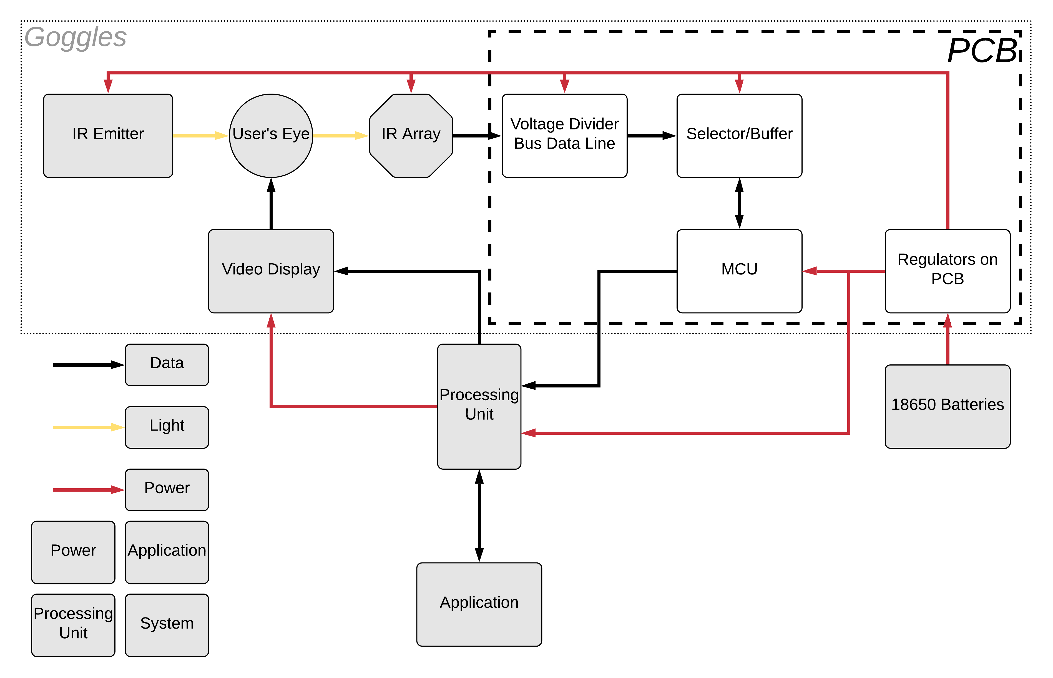
PCB
Notes:
Mike

Slide 15
Converter board
Notes:
Mike

Slide 16
Power Systems

Slide 17
Primary Board Logic

Slide 18
I/O Ports
Sensor Inputs
Power I/O
JTAG
Programming
Interface
Additional GPIO

Slide 19
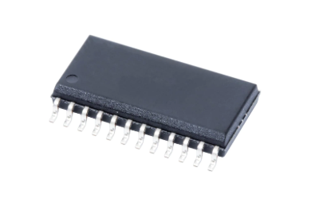
Reasoning for and comparisons of the Selector Chip
There are 16 individual sensors and each output analog signal
The converter can only do one source at a time
None of the sensors can share lines directly
Chip | Configuration | Resistance | Delay | Cost per unit | Place ordered
CD4067B | 16 to 1 | 125 Ω | 220ns | $1.34 | digikey.com
CD74HC4067M | 16 to 1 | 160 Ω | 51ns to 49ns | $0.93 | digikey.com
CD74HC4067M96 | 16 to 1 | 160 Ω | 51ns to 49ns | $0.80 | digikey.com
MPC506AU/1K | 16 to 1 | 1.5k Ω | 200ns to 250ns | $14.49 | digikey.com
CD74HCT4067M | 16 to1 | 180 Ω | 60ns to 55ns | $0.93 | digikey.com
Notes:
Mike

Slide 20
Analog to Digital Converter Chip Comparisons
Converter | Resolution | Cost | Shop
AD7829BRZ | 8-bit | $11.99 | mouser.com
MSP430FR6989 | 12-bit | $8.30 | Digikey.com
TLC0820AIDW | 8-bit | $5.98 | mouser.com
MCP3008 | 10-bit | $3.75 | adafruit.com
ADS10151DGSR | 12-bit | $2.76 | Digikey.com
Need to convert voltage values
The ability to Control the timing and pathing for the data
The speed needed to make it function in time with the user input
Notes:
Mike

Slide 21
Progress of the PCB
Successes
Difficulties
Design completed
Order status : should arive next week
The complexities of the process to order the PCB
Devices on the PCB require different voltages for operation
Notes:
Mike

Slide 22
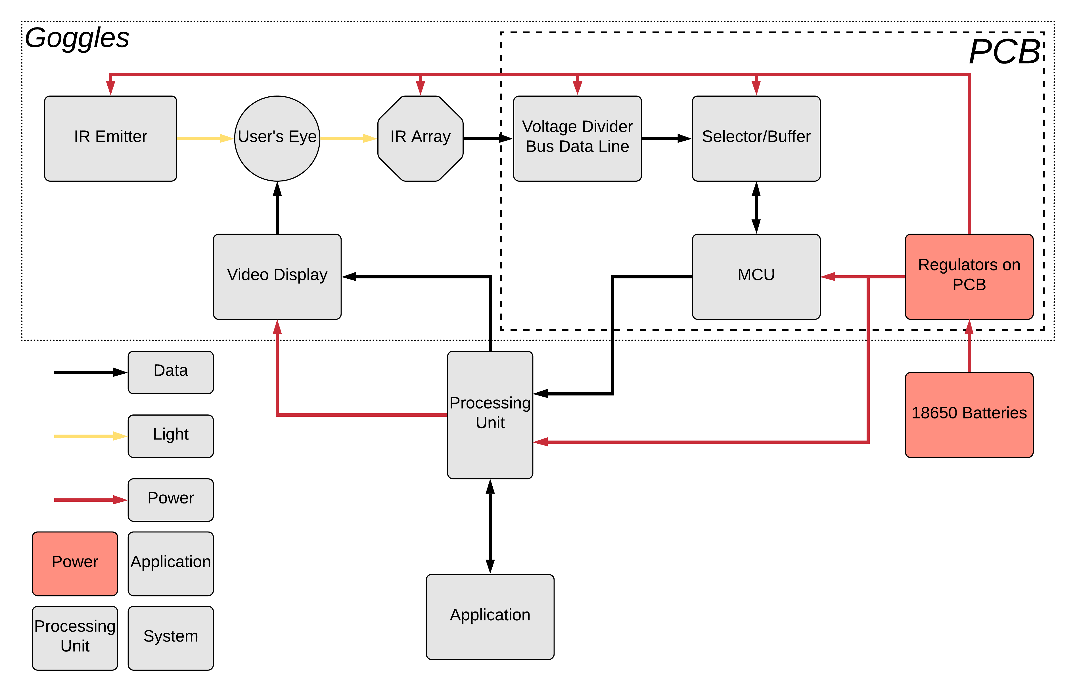
Power
Notes:
Jimmy

Slide 23
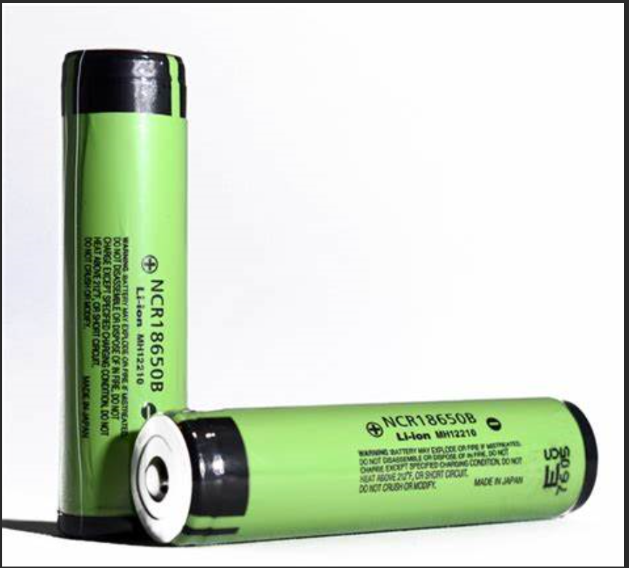
Power system
Runs off 2x ( LG HG2 18650 ) batteries
Output 5v to the converter board and 5v wire tap
Power the pi and display through wire tap to micro USB
Notes:
Jimmy

Slide 24
Power Consumption
Device | Power Consumption (Theoretical Max)
Microcontroller | ~4mA (100uA/MHz)
Raspberry Pi | 400mA
LCD Display Panel | 800mA
Sensor Array | 520mA
TOTAL | 1724mA
The LG HG2 18650 batteries are rated for 3000mAh
Using 2 in parallel should allow for more than 3 hours of operational time
Notes:
Jimmy

Slide 25
Progress of the Power
Successes
Difficulties
Found Batteries to power our device
Changed design from using lithium battery packs
Notes:
Jimmy

Slide 26
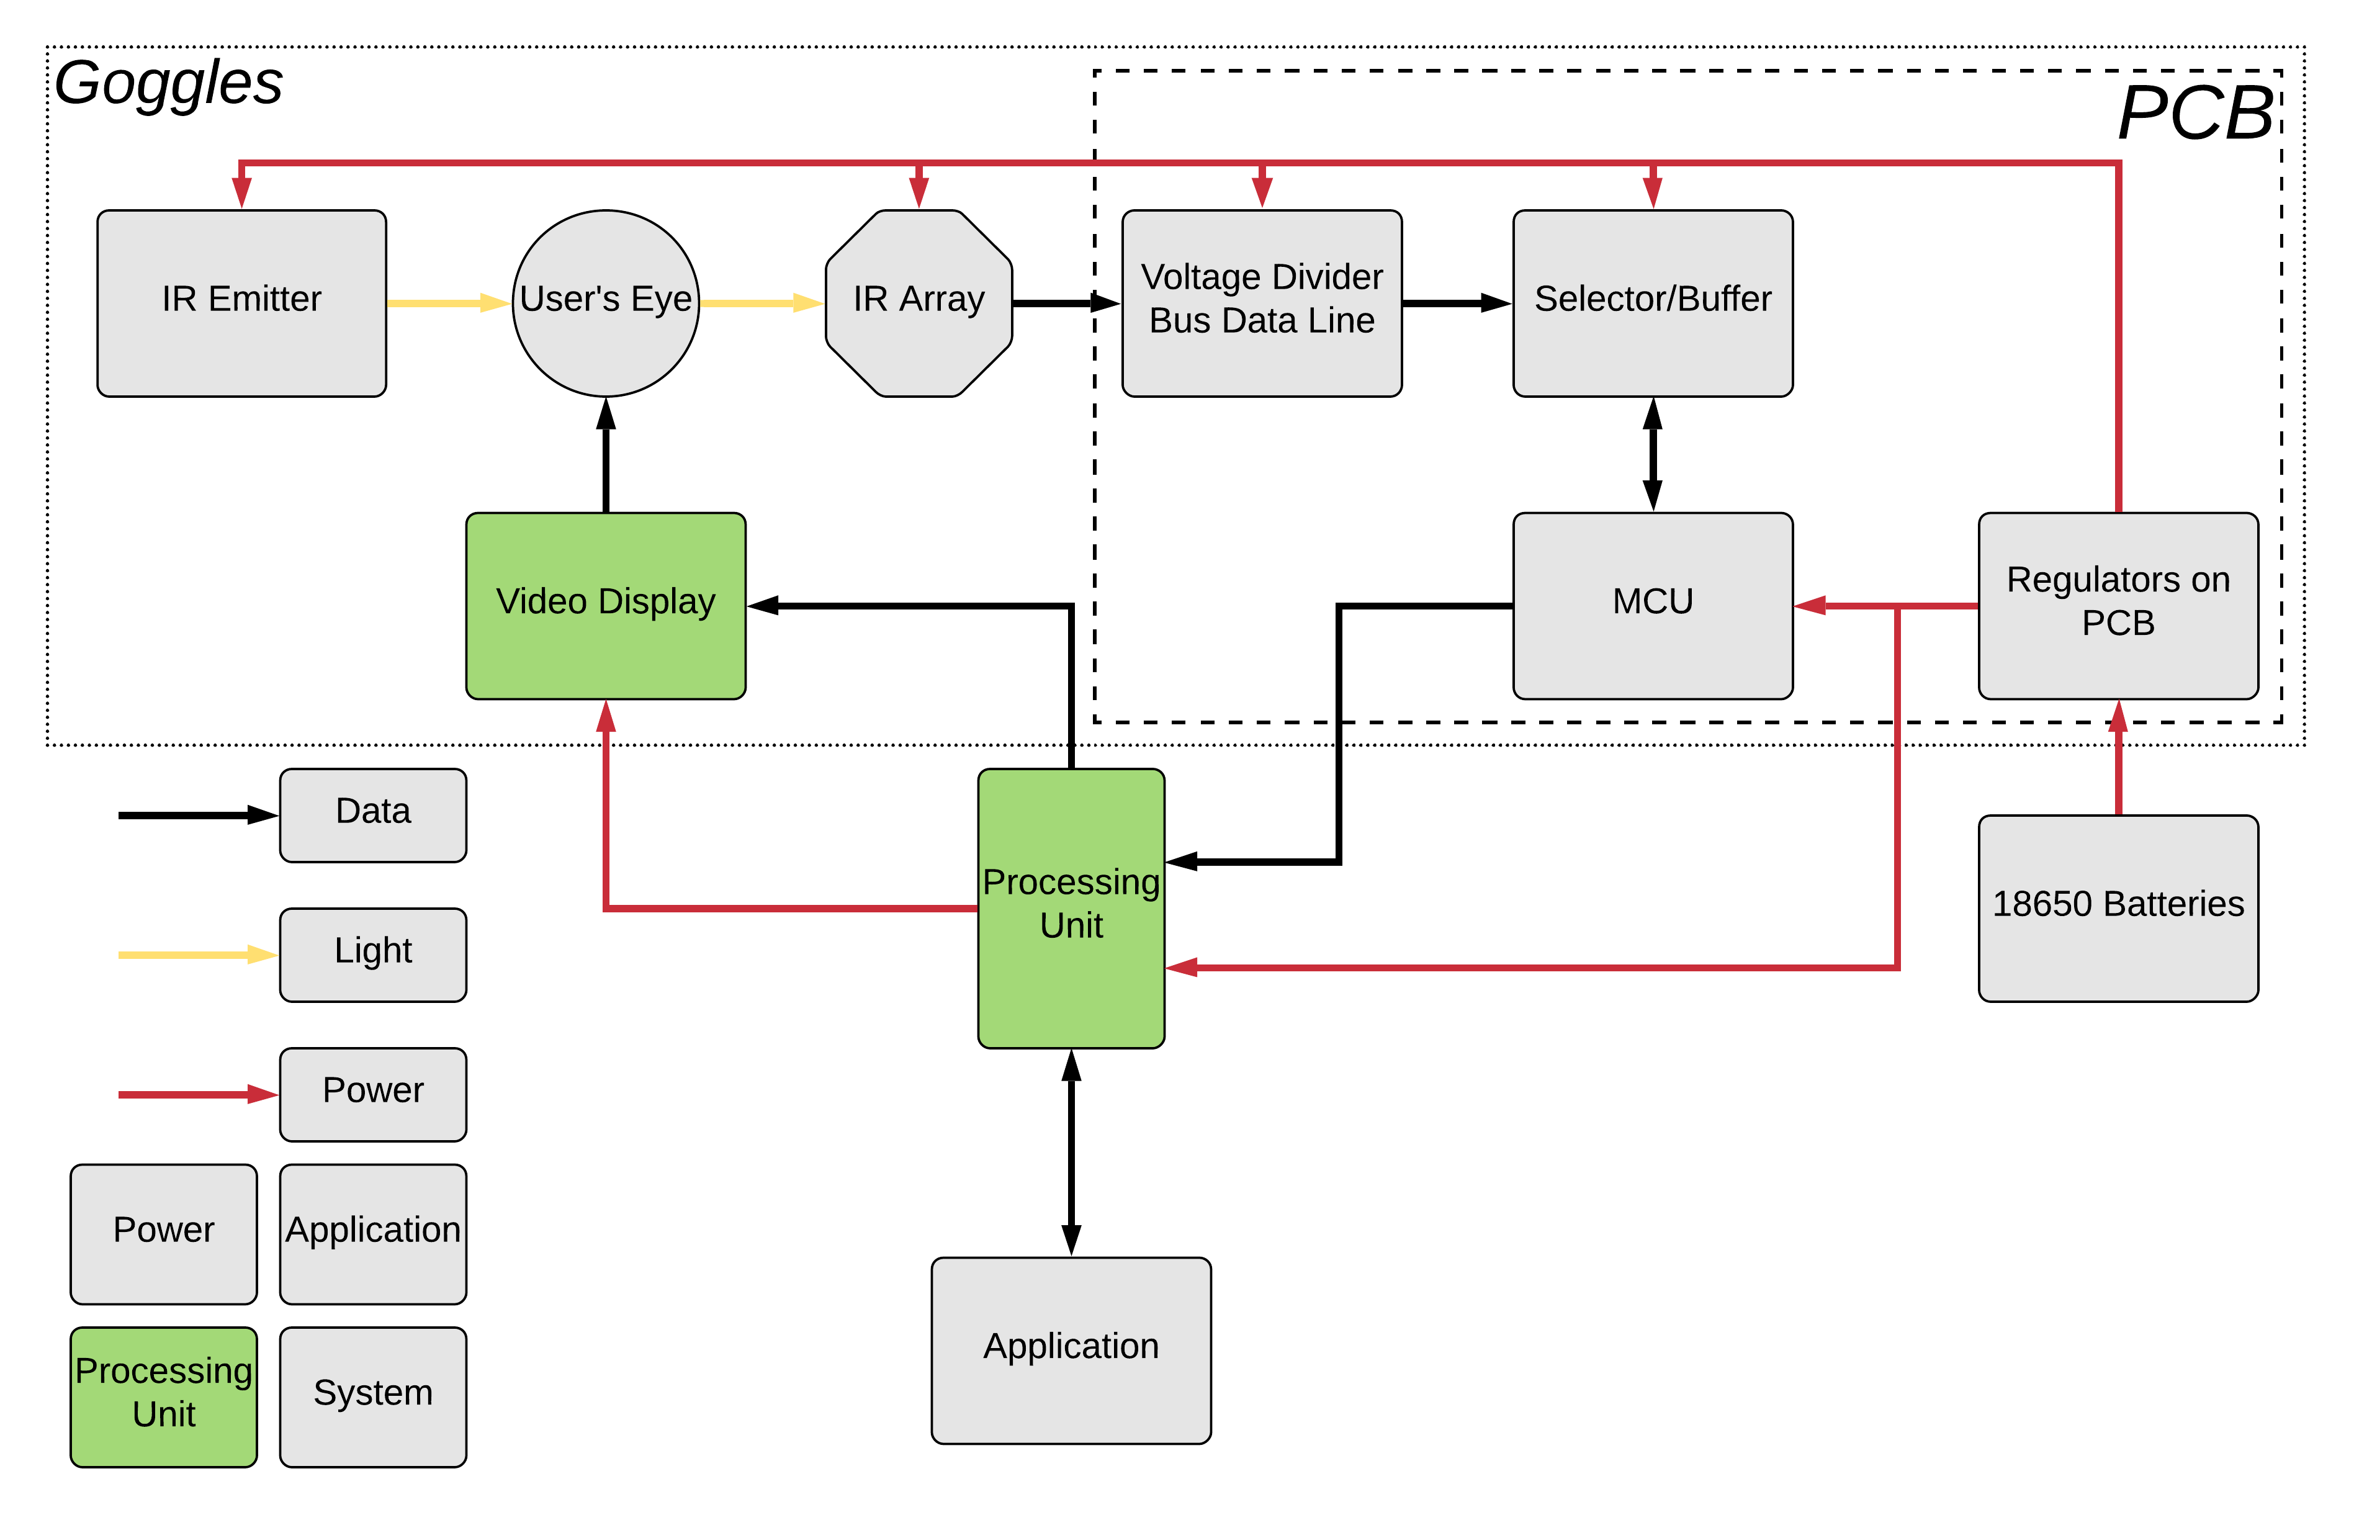
Processing Unit

Slide 27
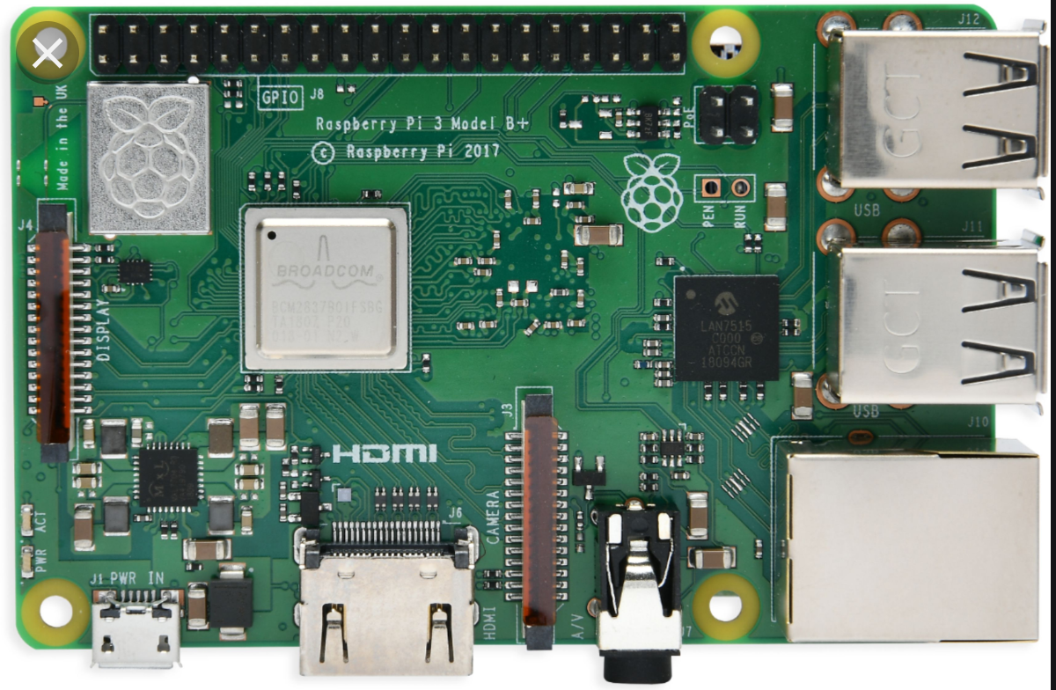
Main Processor Unit
Needs multi-core
Video capability
Name | Price (USD) | CPU clock speed | Size (in)
Rock64 | 44.95 (pine64.org) | 1.5GHz | 2.2x3.4
VIM2 v1.4 Basic | 79.99 (khadas.com) | 1.5GHz | 2.3x3.2
Raspberry Pi 3 model B | 47.69 (amazon) | 1.5GHz | 2.2x3.3
ASUS Tinker Board S | 89.40 (amazon) | 1.8GHGz | 4.5x6
ODROID-XU4 | 49.00 (hardkernel.com) | 2GHz | 2.3x3.3
Notes:
Patrick

Slide 28
Progress of the Processing Unit
Successes
Difficulties
Raspberry Pi has been acquired and loaded with a Linux OS
Pi is able to interface with the goggles display
Communication of the Raspberry Pi with the MCU

Slide 29
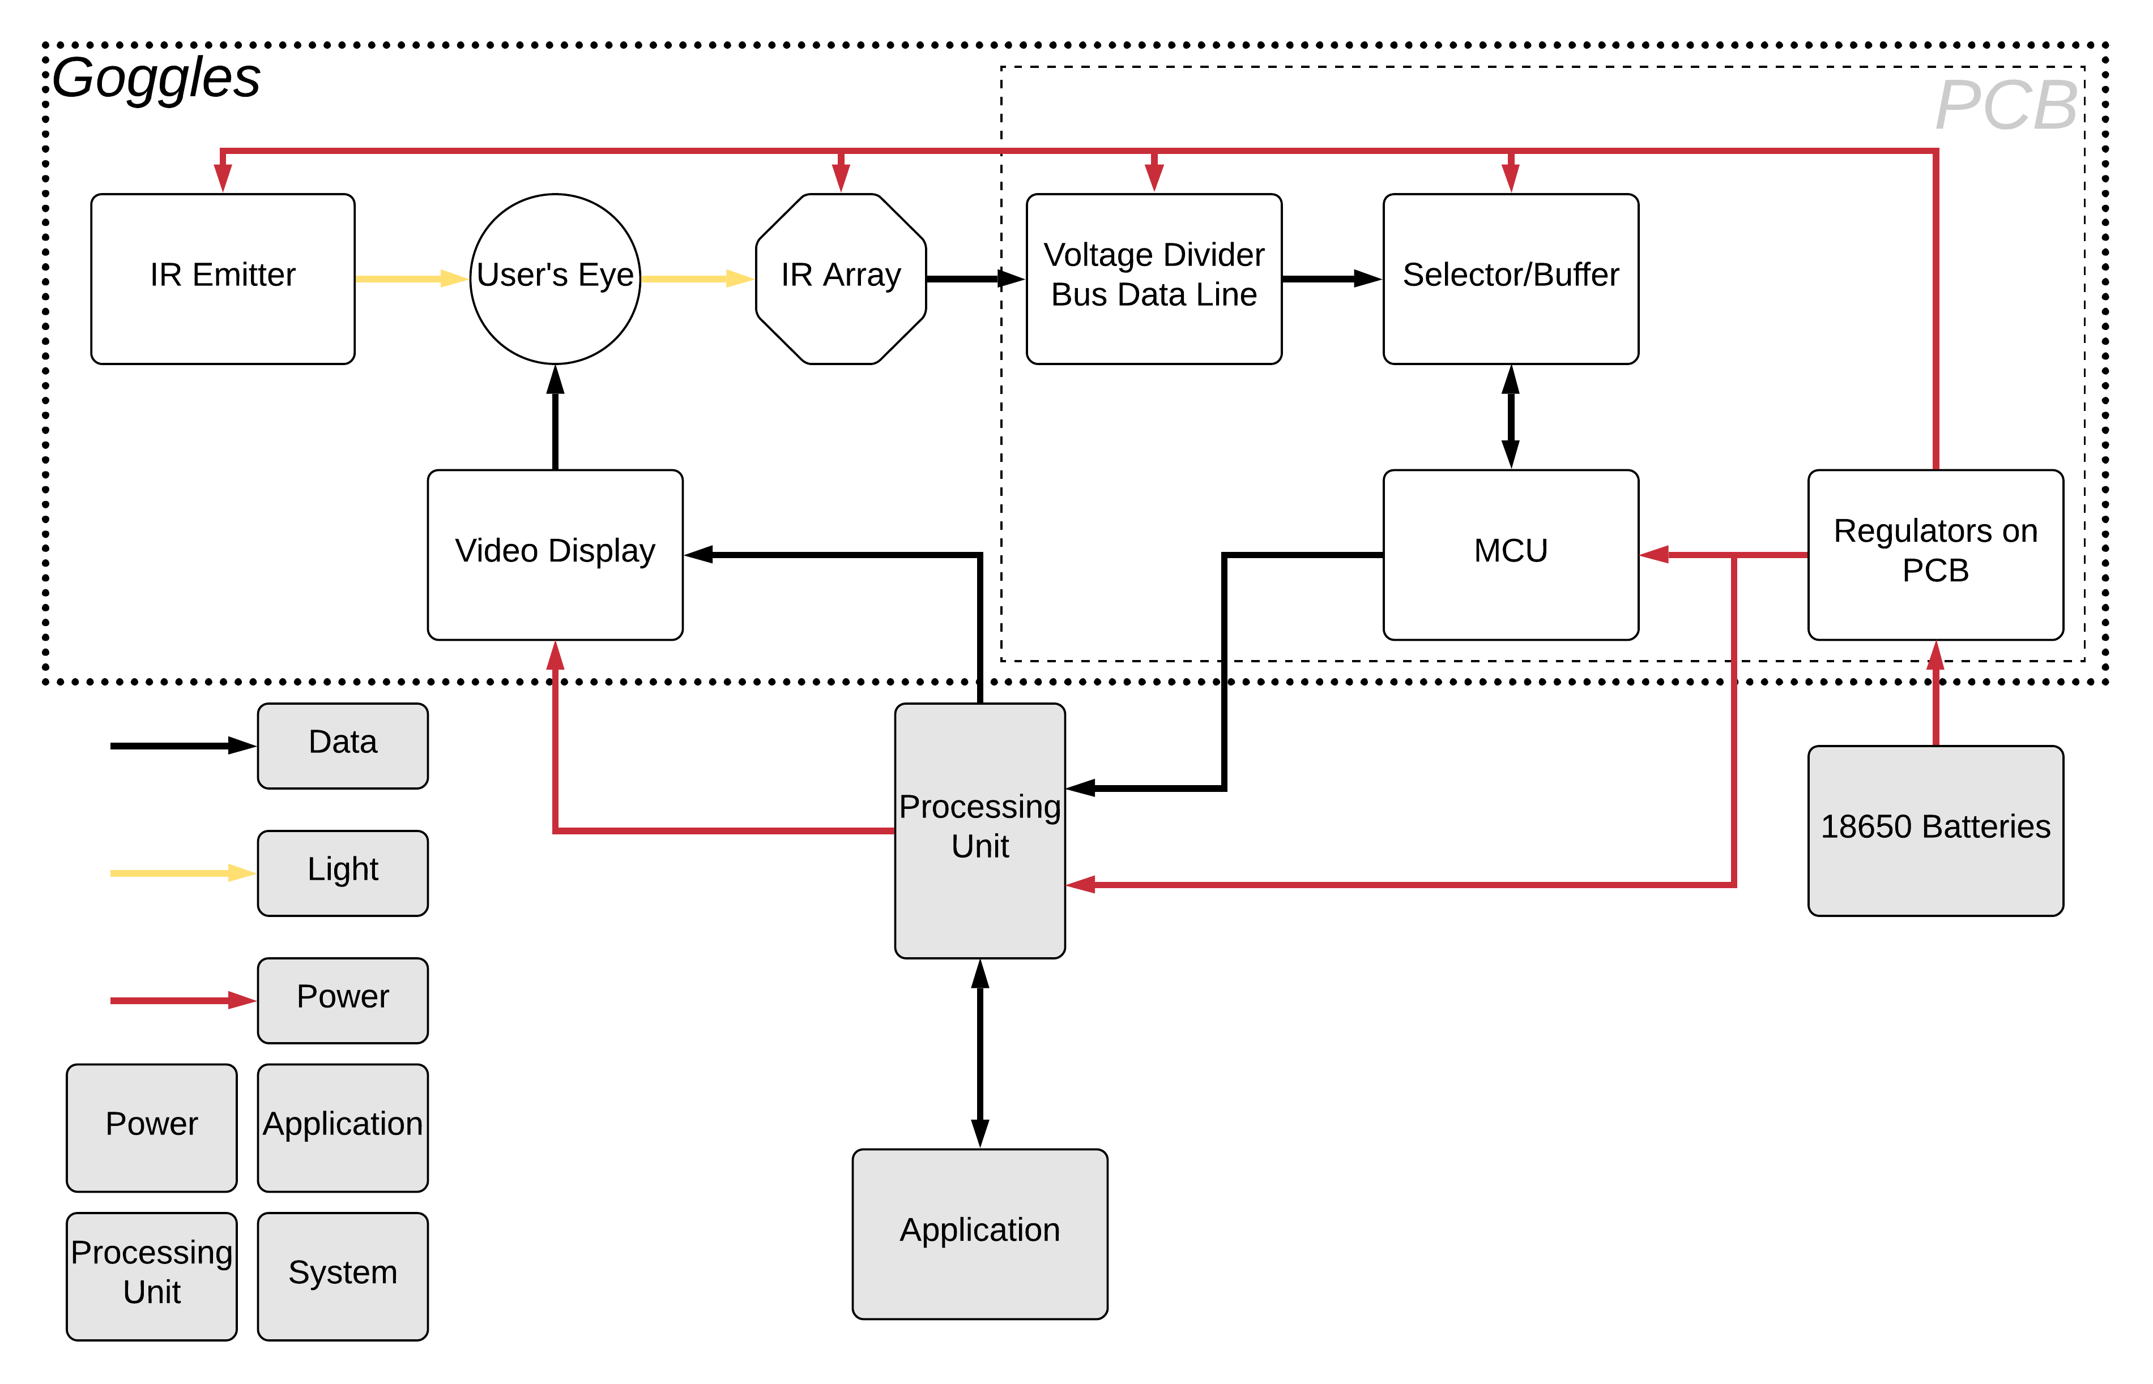
Goggles

Slide 30
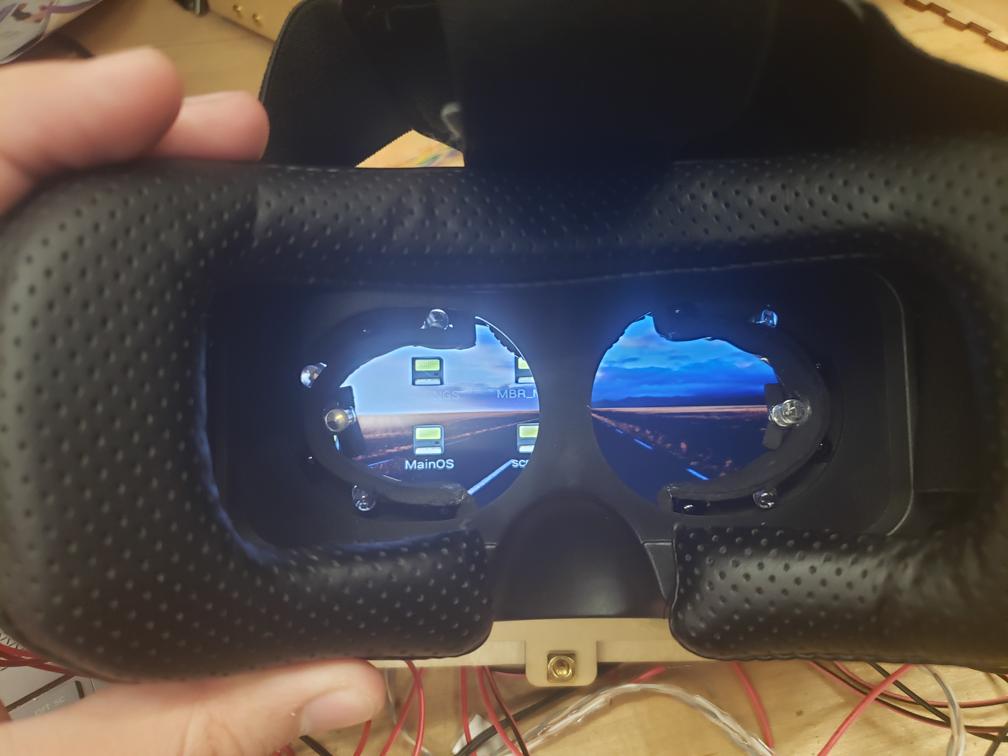
Comparison of Goggles
Product | Structure | Straps | Plus or Negative | Cost | Shop
UTOPIA360 | Solid plastic | T shape | Adjustable focus Leather seal | $36.82 | Walmart
Google Cardboard | Cardboard | Single | Not durable and cheaply made | $18.79 | Walmart
Self built | EVA foam | Any | Takes time to make | Un-known | Any-where
Google Daydream View | Hard plastic | Single | Can’t be modified easily | $79.99 | Walmart
Notes:
Jimmy

Slide 31
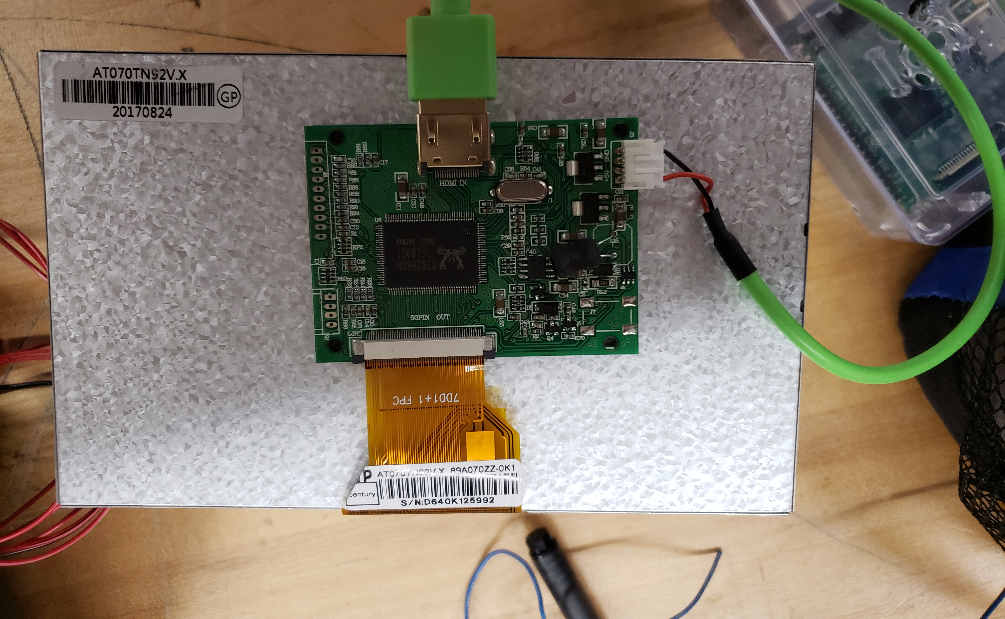
Piper LCD Display
9 inch display
Runs on 5v, 500mA
HDMI input
Compatible with Raspbarry pi video drivers
Notes:
Jimmy

Slide 32
Progress of the Goggles
Successes
Difficulties
Attached the IR Transmitters
Attached the IR Receivers
Attached the screen
Had to take off the front to fit the screen on
Notes:
Jimmy

Slide 33
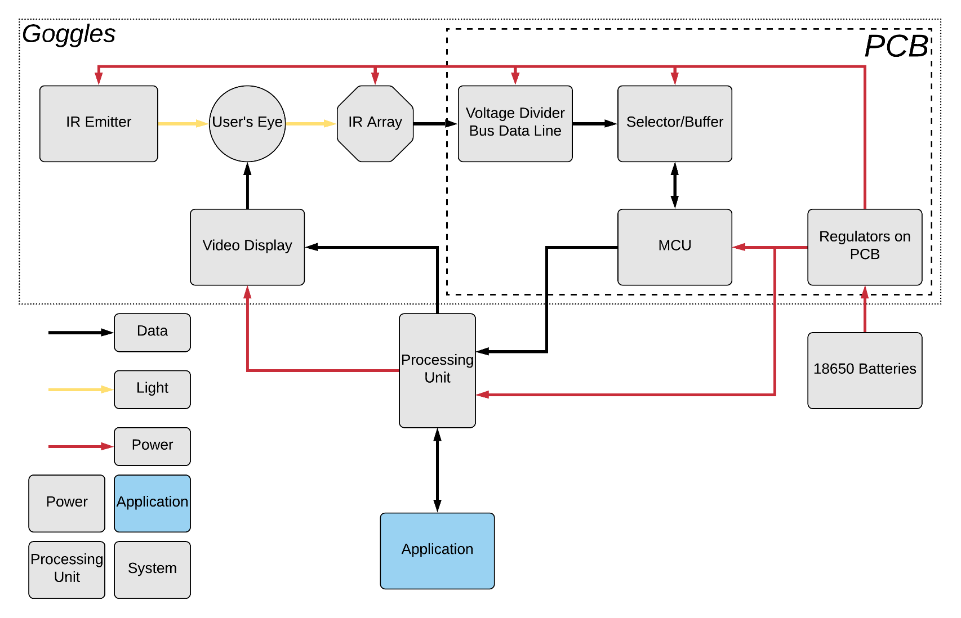
Application

Slide 34
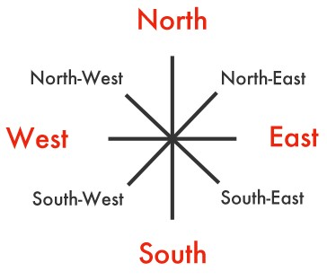
Application
We will be using a Technical Demonstration to test the accuracy of our algorithm.
We will be testing the Cardinal Directions and the directions in between the Cardinal Directions (North, South, East, West, North-West, North-East, South-East, South-West)

Slide 35
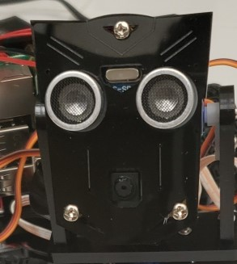
Stretch Goal
Our Stretch Goal for the Project is an application utilizing a camera mounted onto a servo motor.
The LCD display on the goggles will show what the camera is viewing in realtime.
The servo motor will be controlled by an algorithm run on the Raspberry Pi. The Algorithm will decipher the data and depending on the gaze of the user of the goggles the servo motor will respond accordingly.

Slide 36
Selecting a Communication Protocol SPI vs I2C
SPI
Single-master, multi-slave system
Full-duplex communication
Requires a minimum of 3 or 4 wires for communication depending on requirements
Faster than I2C
Draws less power than I2C
More susceptible to noise than I2C
I2C
Multi-master, multi-slave system
Half-duplex communication
2 wires required for communication
Slower than SPI
Draws more power than SPI
Less susceptible to noise than SPI
Notes:
Patrick

Slide 37
Progress of the Application
Successes
Difficulties
Had to change from using the device to operate a camera
Notes:
Patrick

Slide 38
Prototype

Slide 39
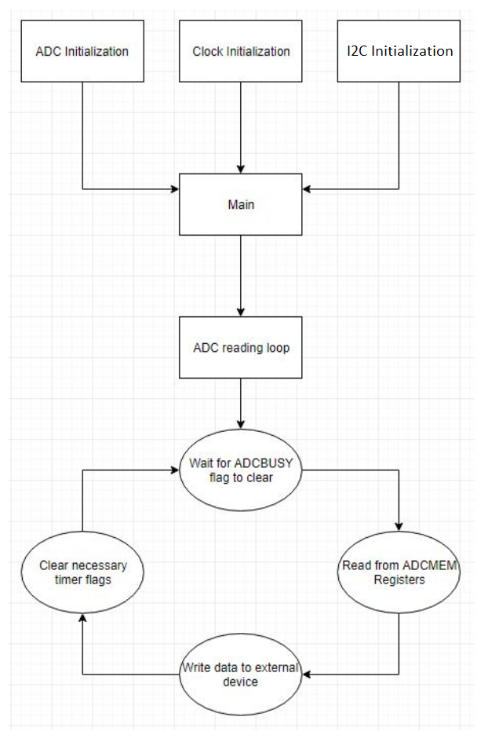
State Algorithm
Programming block representation of functional msp430 code
Notes:
Mike

Slide 40
Machine Learning
Model will take the 16 sensor values to predict the eyes current position
The model will be trained using sampled data with the known eye positions
Preliminary testing will be done in in Python using the Keras API, which is specifically designed to create easy-to-use deep learning models
Notes:
Mike

Slide 41
Budget
Item | Supplier | Cost | # Units | Total Cost
Raspberry Pi | Amazon | $64.99 | 1 | Omitted
MSP 430 | digikey | $10.44 | 1 | Omitted
Selector Chip | digikey | $0.98 | 10 | $9.80
Goggles | Walmart | $49.50 | 1 | Omitted
Miscellaneous | Walmart | $8.00 | 1 | $8.00
IR Transmitters | Radioshack | $2 | 5 | $10.00
IR Receivers | Radioshack | $1.50 | 14 | $21.00
PCB | Quality manufacturing services inc. | $121 | 5 | $121
Total |  |  |  | $169.80
Notes:
Jimmy

Slide 42
Work Distribution
Notes:
Jimmy

Slide 43
Current Progress
Notes:
Jimmy

Slide 44
Immediate Plans
Test PCB
Finish putting everything together so we can start final testing and working on the coding
Notes:
timothy

Slide 45
Questions?

